Slide 1
APACHE SERVER
Presented By:
GOWDHAM .S

Slide 2
What is the Apache HTTP Server?
Apache is free and open-source software of web server that is used by approx 40% of websites all over the world
Apache HTTP Server is its official name. It is developed and maintained by the Apache Software Foundation
The aim of the web servers is to deliver websites over the internet. It behaves as a middleman among the client machines and servers to achieve that aim.

Slide 3
Key Features Apache HTTP Server:
Open Source and Free: Apache is open-source software, which means it’s free to use and modify.
Cross-Platform → Linux, MacOS and Windows
Virtual Hosting → Supports hosting multiple websites on a single server using the same or different IP addresses.
Security Features →Includes SSL/TLS support, access control, and more.

Slide 4
Necessities of Apache Server :
Enabling Web Access
Serving Content to Users
Secure Data Transmission
Efficient Resource Management and Virtual Hosting
Performance and Scalability
Logging and Monitoring

Slide 5
Why we are using Apache:
Apache’s extensive module system allows for customization →SSL,URL,PROXY SERVICES,STRONG SECURITY FEATURES,SSL/TLS.
Additionally, its community support and ease of integration with various programming languages (like PHP, Python).

Slide 6
Functions of Apache web Server
Its core job is to handle requests from clients (like web browsers) and respond with web content, such as HTML pages, images, or data
1. Serving Web Pages
2. Virtual Hosting → Name and IP based VH
3. Load Balancing
4.Security → SSL/TLS
5.Logging and Monitoring

Slide 7
APACHE CONFIG REQUIREMENTS:
Package: httpd
Port no: 80 & 443
Default Config: vi /etc/httpd/conf/httpd.conf
Own config: vi /etc/httpd/conf.d/___.conf
Services: httpd

Slide 8
Pros and Cons apache Server:
pros
Open-source and free, even for commercial use.
Reliable, stable software.
Frequently updated security patches.
Flexible due to its module-based structure.
Easy to configure, beginner-friendly
cons
Performance problems on extremely traffic-heavy websites.
Too many configuration options can lead to security vulnerabilities.

Slide 9
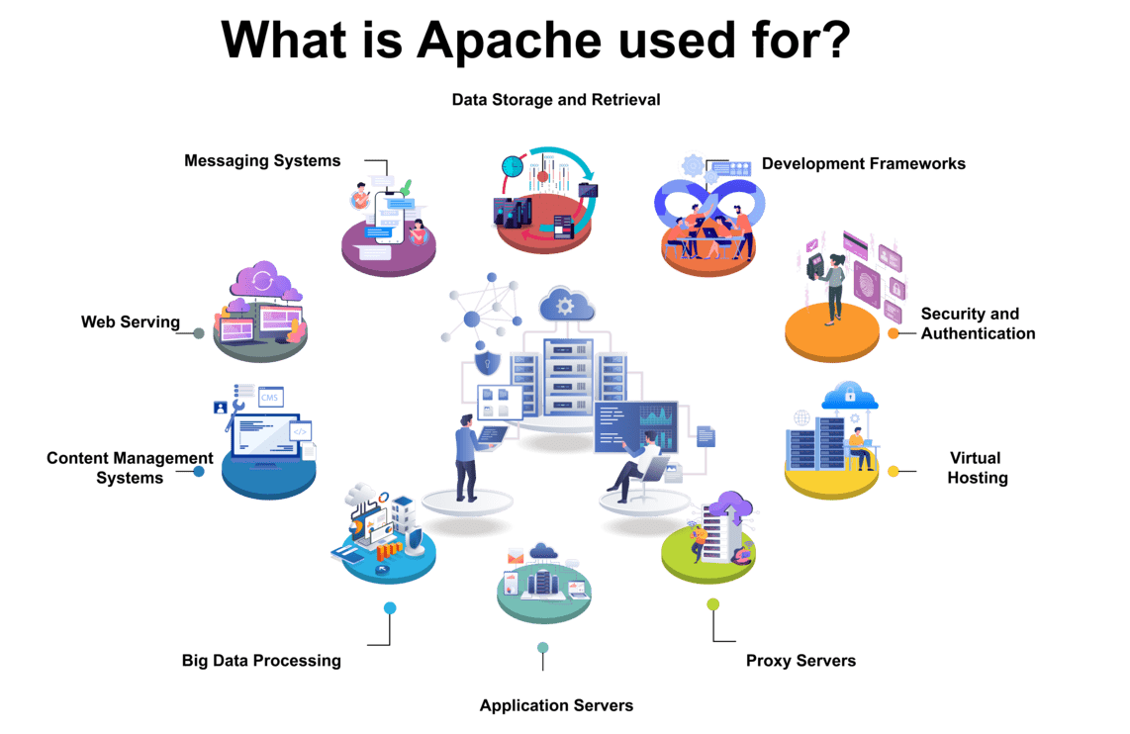

Slide 10
THANK YOU

